Slide 1

INRODUCTION TO ARDUINO
STEM
Notes:
For some context about who I am and why im standing here, Im CWO Lucas Clark, I am currently doing my degree apprentiship with univeristy of sunderland and Procter and gamble, I spent a few months at the start of my career studying and using some arduinos / more advanced chips so I have some idea of what I am talking about.

Slide 2
INTRODUCTION TO ARDUINO
Objectives
By the end of the session, you will be able to:
Describe what an Arduino is
Discuss some examples of what type of devices can be controlled and used by an Arduino board.
Describe what the different types of 'Pins' are on an Arduino board and what they do
Describe how to program to an Arduino Board.

Slide 3
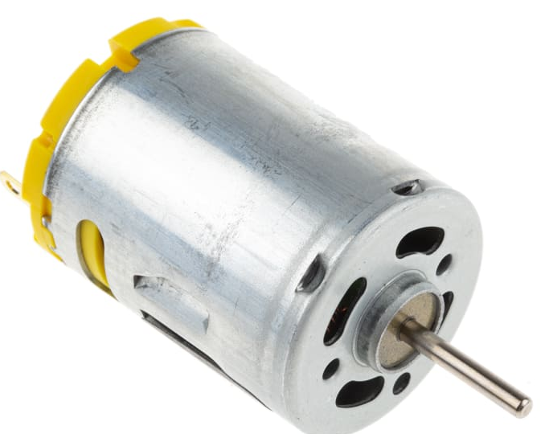
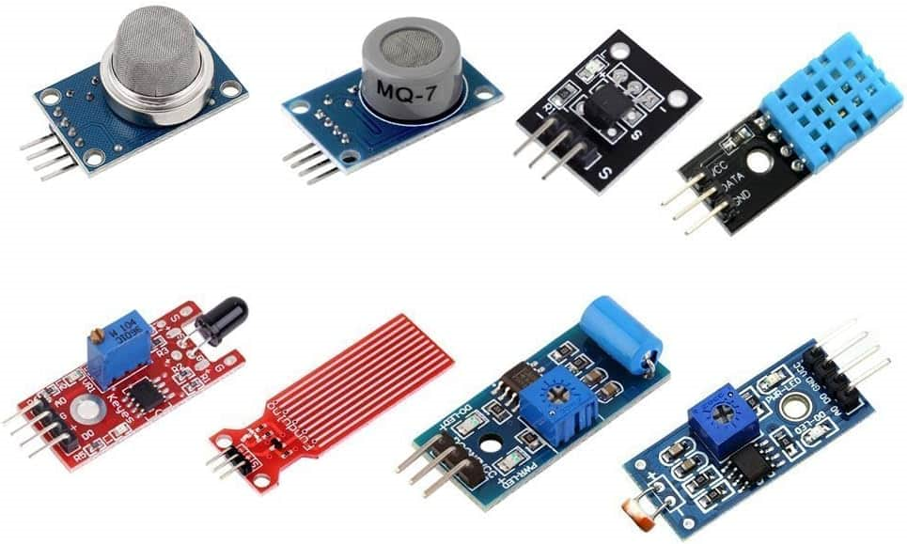

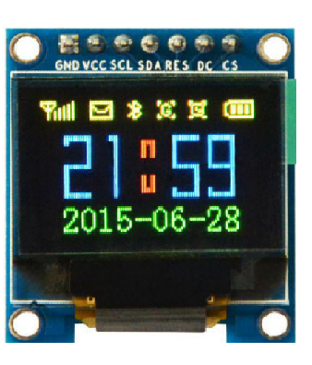
INTRODUCTION TO ARDUINO
What is an Arduino?
An Arduino board is a small computer that you can use to control electronic devices.
Like a tiny brain that can be programmed to do specific tasks and actions.
Notes:
An Arduino can be used to control and use a huge range of types of devices: motors, lights, displays, sensors and many more. Can you think of anything you might want to control to make a car?
The actual brain function of the arduino comes from the microprocessor which contains the code and logic that you code.
If you want to know more about how a microproccess works come and talk to me!

Slide 4
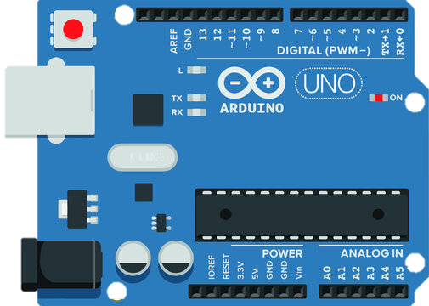
INTRODUCTION TO ARDUINO
Power
Analog
Digital
Notes:
There are 3 main types of pins on an Arduino board:
Power
Analog
Digital
Hand out the arduinos at this point.
Can you all identify where the types of pins are?

Slide 5
INTRODUCTION TO ARDUINO
Power Pins
Power pins allow for the powering of components connected to the board. To supply power to the board there are a few ways to do it.
There is a V_{in} pin on the board.
There is a barrel jack connector.
There is the USB-B connector.
The Arduino Uno requires between 6V - 20V power supply
Notes:
Point to the powering points

Slide 6
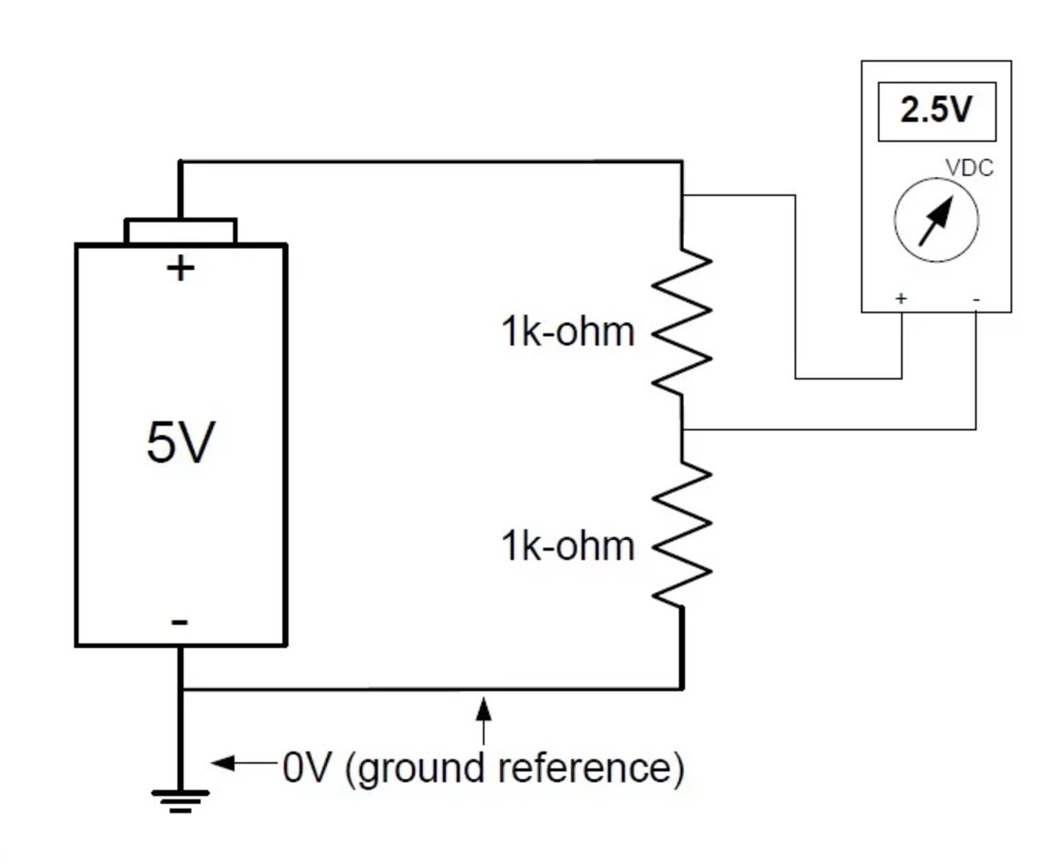
INTRODUCTION TO ARDUINO
Ground Pins (GND)
Grounding is required in all circuits just as Voltage / Power pins are
The current in a circuit travels from a power source such as a battery and travels towards the ground
This flow is what powers electrical devices
Ground pins have a few main purposes: completing circuits and providing a stable electrical reference point.
This allows for the smooth running of devices and the completion of the circuit.

Slide 7
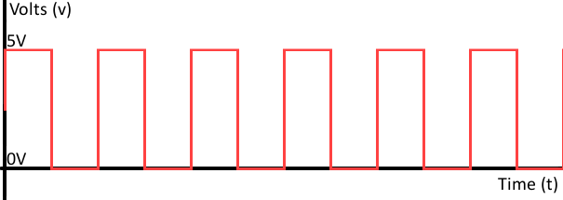
INTRODUCTION TO ARDUINO
Digital Pins
Digital signals are discrete signals. This means they can either be on or off.
Notes:
Can you think of any examples of devices which may use digital signals ie: on and off?

Slide 8
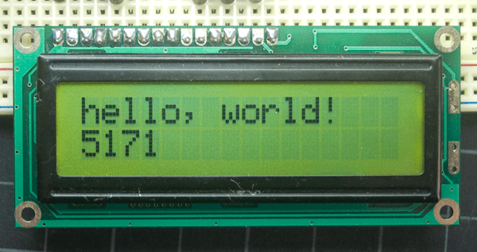
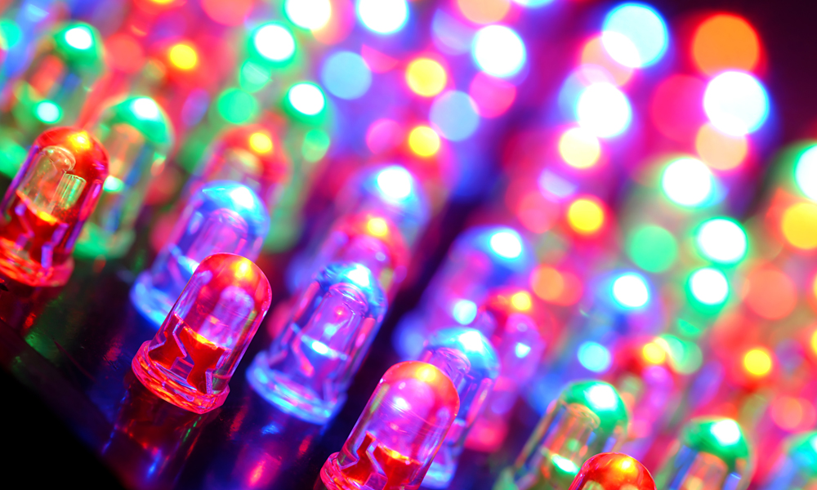
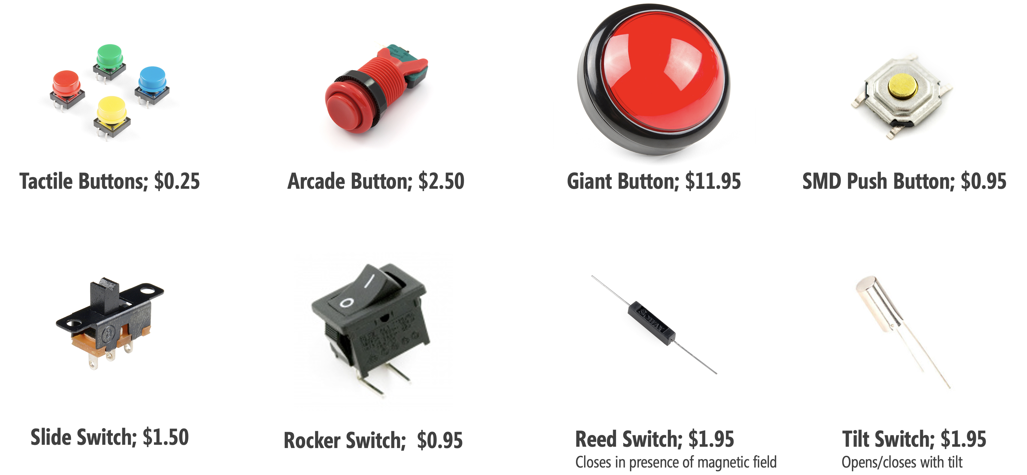
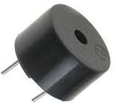
INTRODUCTION TO ARDUINO
Digital Signal Devices
Notes:
Can you think of any examples of deivces which may use digital signals ie: on and off?

Slide 9
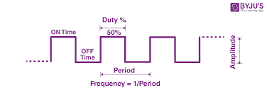
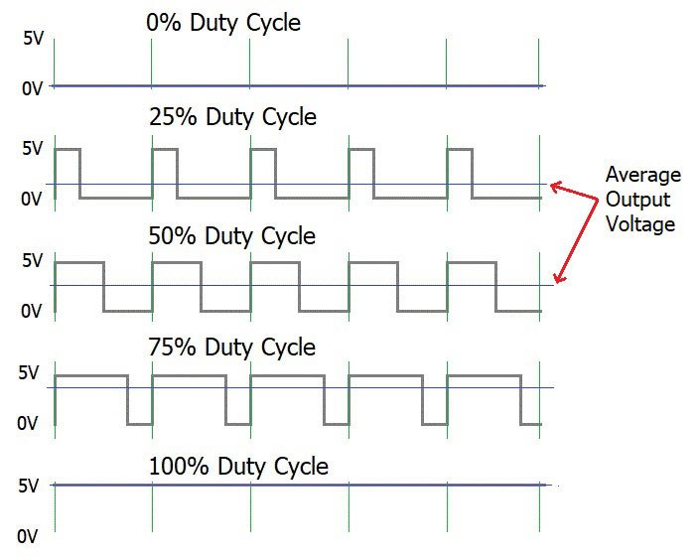
INTRODUCTION TO ARDUINO
Digital Pins - PWM
Pulse Width Modulation (PWM) is a technique used to control the amount of power delivered to a load by changing the width of a 'pulse'.
PWM can simulate varying levels of analog voltage, enabling precise control of devices such as motors, LEDs, and audio amplifiers.
Notes:
Can you think of any reason as to why we might use PWM?

Slide 10
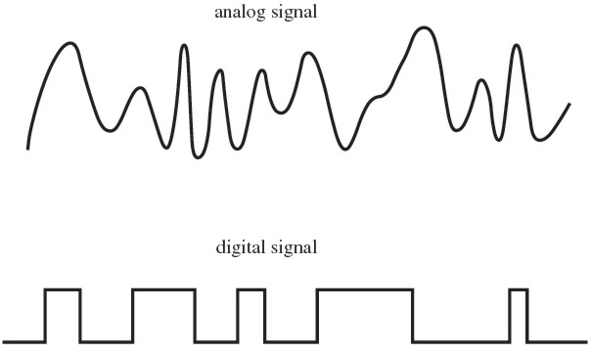
INTRODUCTION TO ARDUINO
Analog Pins
Unlike digital signals that are either high (5V) or low (0V), analogue signals can take on any value within this range.
Analogue signals are great for sensors where you want very precise information.
Notes:
The Arduino's analog pins have an Analog-to-Digital Converter (ADC) that converts these analog voltages into digital values that the microcontroller can process, enabling the Arduino to read and respond to analog inputs from sensors or other devices. This allows for a wide range of applications where precise measurement and control of analog quantities are needed, such as in environmental monitoring, audio processing, and sensor-based systems.

Slide 11
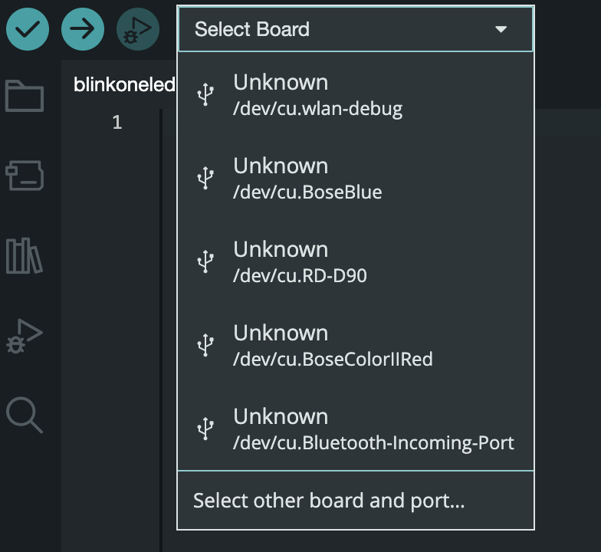
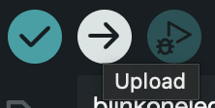
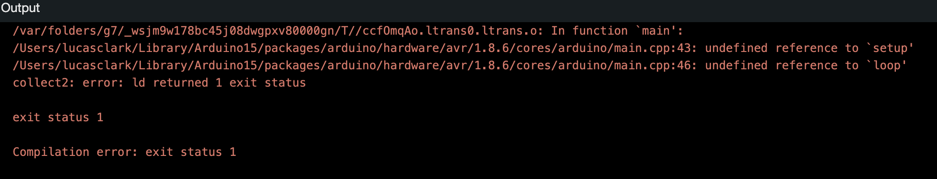
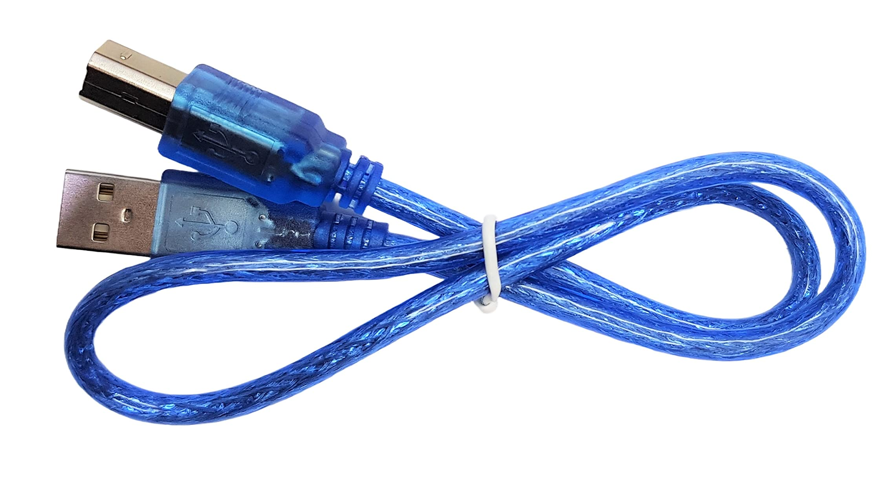
INTRODUCTION TO ARDUINO
How to Program Arduino
Arduinos can be programmed using the Integrated Development Environment (IDE). We program what we want each pin to output/input
Notes:
Get them to open up their IDEs walk through all of the points in message, make sure they all know where all of the buttons are.
Errors will be highlighted and you can use this error message to decipher what is wrong with your code.

Slide 12
INTRODUCTION TO ARDUINO
Any Questions?
Notes:
Get them to open up their IDEs walk through all of the points in message, make sure they all know where all of the buttons are.
Errors will be highlighted and you can use this error message to decipher what is wrong with your code.

